Slide 1


KLiK Engine
A C++ Based File Search Engine

Slide 2

Muhammad Saad Hussaini – 211190
Anas Imran Tasadduq – 237770
SE 8A
Ahmad Ali Khan – 211236
Muhammad Shaharyar - 211690

Slide 3






KLiK Engine
C++ / PHP File Search Engine
The Search Engine is created in C++, utilizing the Boost Library to facilitate the file I/O. The GUI was made in PHP, which receives output from C++ scripts
The chosen Dataset was the Enron Email Dataset, which was over 1.54 GB large and consisted of more than 540000 records.

Slide 4



Chosen Dataset
Email Dataset
1.54 GB
540000+ files (I/O heavy)
File-section priority required (Subject vs Body)
Enron Email Dataset

Slide 5










Languages and Frameworks
BootStrap 4
C++ Boost Library
HTML / PHP
MySQL / MySQLx APIs
C++

Slide 6






Basic Procedures
Forward Indexing
Reverse Indexing
Result retrieval and Ranking
Result Display

Slide 7
Main Work Distribution
Anas Imran Tasadduq
Muhammad Shaharyar
Added the first step of ranking system (TF calculations)
Added index to database
Added the second step of ranking system (IDF calculations)
Added index to database
Forward Indexing
Reverse Indexing
Muhammad Saad Hussaini
Searcher / Ranking
GUI
Ahmad Ali Khan
Calculated ranks
Handled single and multi word queries
Implemented PHP for GUI
Accessed C++ script for searching

Slide 8


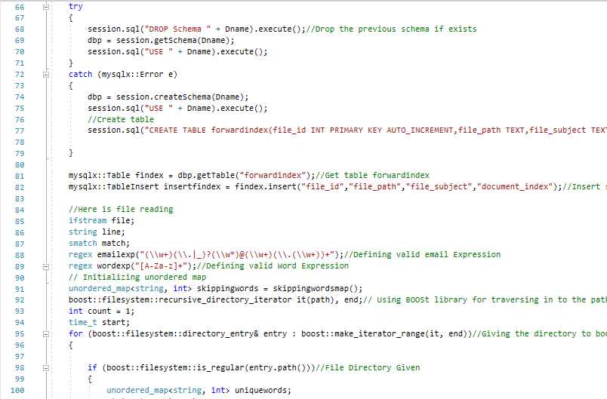
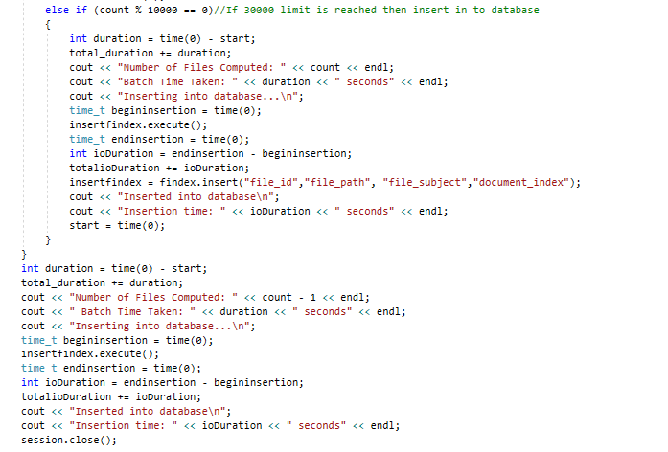
Forward Indexing
Coded on C++
Implemented Boost Library for I/O efficiency
Incremental processing of 10,000 files
Entire File path stored for later ease

Slide 9
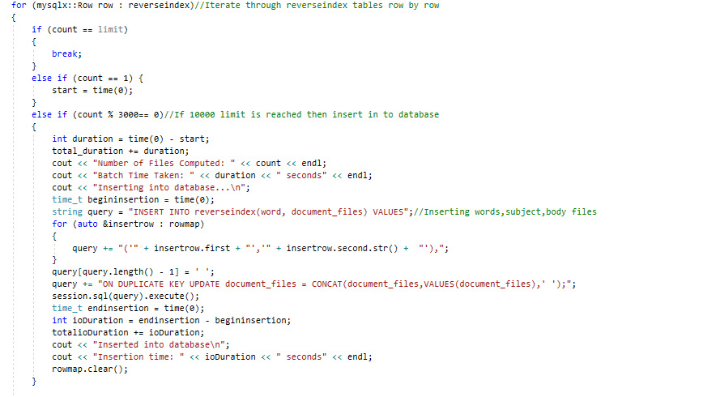
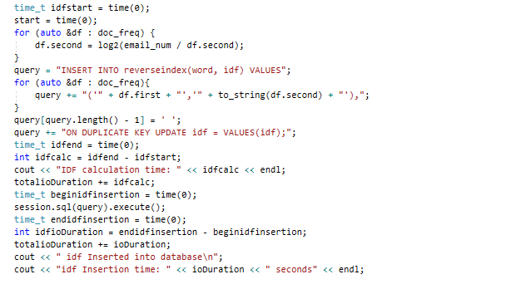
Reverse Indexing
Implemented Forward Index
Data prioritization
Incremental processing of 10,000 files

Slide 10

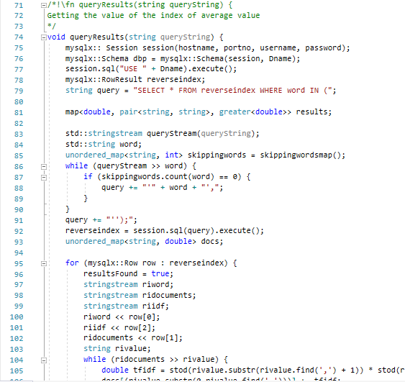
Searcher
Implemented Reverse Indexing
Stop Words completely separated
Results Ranked in accordance to priority
String streams used for data efficiently

Slide 11
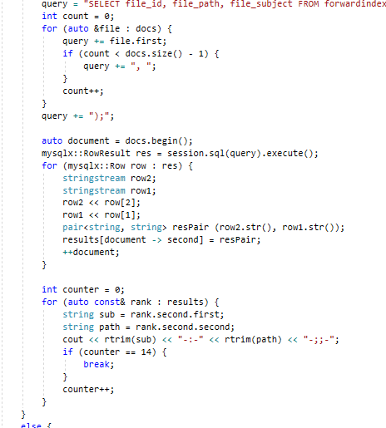
Ranking
Positional priority ranking
Top 15 results returned.
Advanced multiple-word query scoring

Slide 12
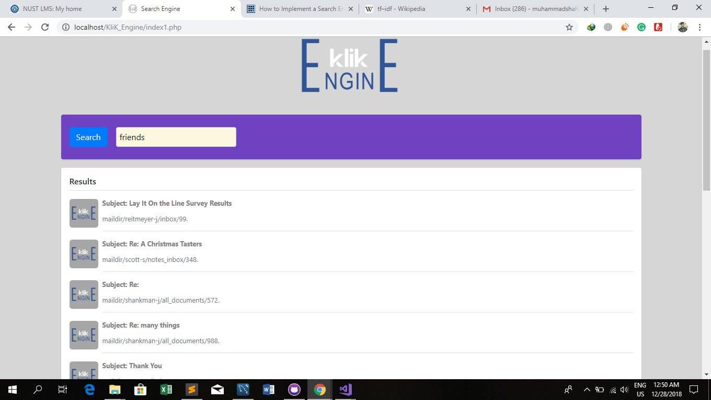
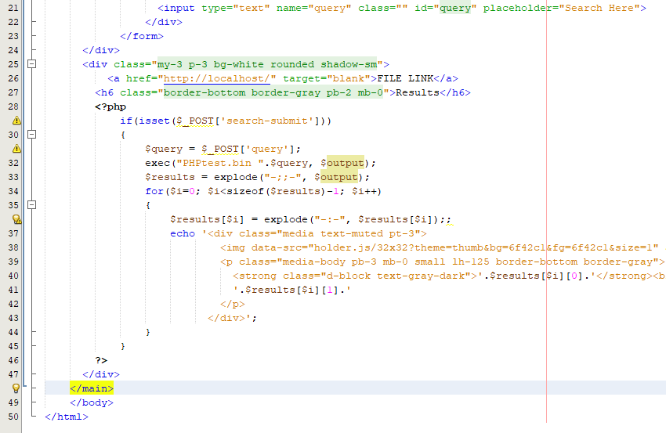
GUI
Implemented PHP for GUI
UI created/designed with HTML/CSS and the BootStrap 4 Framework
C++ script used for searching
Time calculation of search-execution
Dealing with no results being returned

Slide 13
Performance
Implemented the Reverse Index
Implemented Document scores
Average query time: 1.20 s

Slide 14



KLiK Engine
End Semester Project Subject : Data Structures and Algorithms
Muhammad Saad Hussaini - 211190 Anas Imran Tasadduq - 237770 Ahmad Ali Khan - 211236 Muhammad Shaharyar - 211690

